Slide 1
Applied Data Science Data Preparation
Dr. Omri Allouche
2017

Slide 2
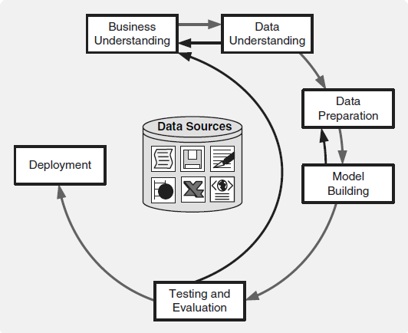
CRISP-DM

Slide 3
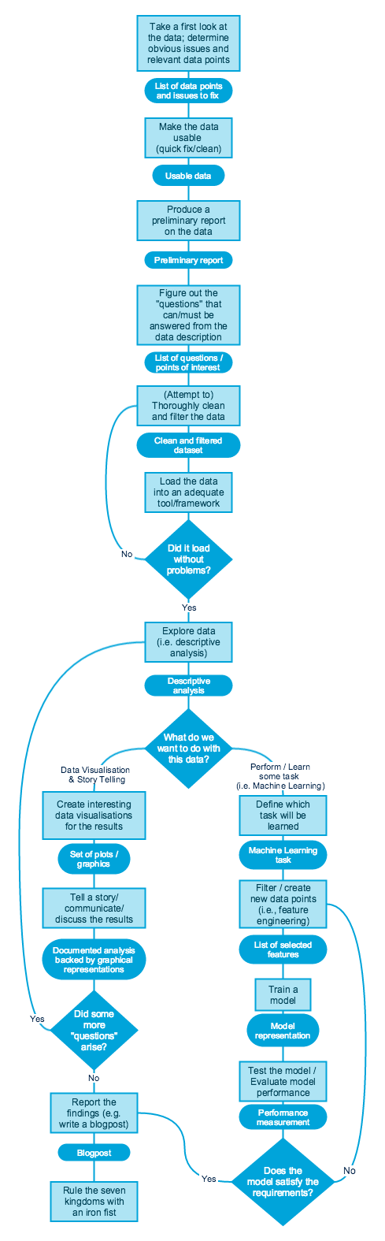

Slide 4
Handling Missing Data
Some slides taken from HJ van Veen’s Feature Engineering Presentation

Slide 5
Why are there missing values?
Problems with data extraction
Incorrect type casting (e.g. using 0 for N/A)
Typos

Slide 6
Missing Data Mechanisms
Missingness completely at random - all variables have the same probability of being missing
Example: respondents of data collection process decide that they will declare their earning after tossing a fair coin.
Missingness at random - some values have higher probability of being missing, that fully depends on other observed variables
Example: We are collecting data for age and females have a higher missing values compare to male.
Missingness that depends on unobserved predictors
Example: In a medical study, if a particular diagnostic causes discomfort, then there is higher chance of drop out from the study. This missing value is not at random unless we have included “discomfort” as an input variable for all patients.
Missingness that depends on the missing value itself (aka Censoring)
Example: People with higher or lower income are likely to provide non-response to their earning.
It’s difficult to tell the different mechanisms apart.

Slide 7
Common Approaches
Drop rows with missing values - leads to shrinkage of dataset, possible bias in estimates
Impute - common but “invents” information
Mean/median/mode imputation
Last value carried forward - use the “before treatment” value
Indicate missing value (see this Quora answer)
For categorial data, add a category “NA”
Add a column indicating “NA” value and use it in the model
Use a predictive model

Slide 8
Common Approaches – Cont.
KNN Imputation
More difficult to impute categorical data
Available case analysis - different aspects of the problem are studied with different subsets of the data
Nonresponse weighting - build a model to predict the nonresponse in that variable using all the other variables. The inverse of predicted probabilities of response from this model could then be used as survey weights to make the complete-case sample representative

Slide 9
Outliers Detection

Slide 10
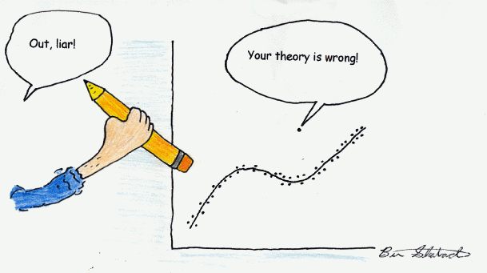
What is an Outlier?
An Outlier is an observation that appears far away and diverges from an overall pattern in a sample.

Slide 11
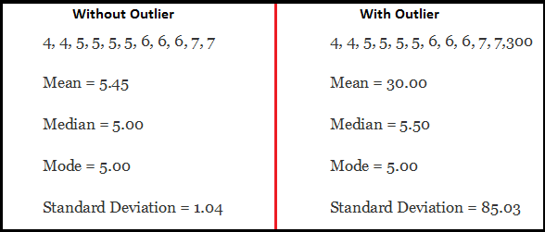
Why Remove Outliers?
Inclusion might lead to wrong results or conclusions
Affect the choice of algorithm
Important for Fraud Detection etc.
Source: Analyticsvidhya
Notes:
Inclusion might lead to wrong results or conclusions
Affect the choice of algorithm
Important for Fraud Detection etc.

Slide 12
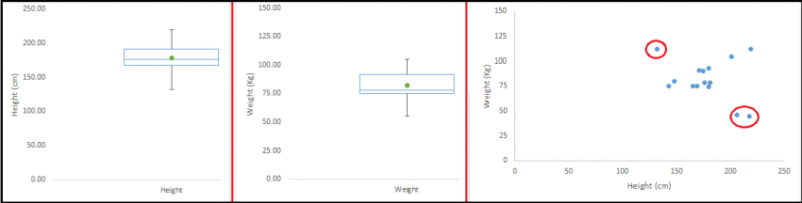
Outliers can be multivariate
Source: Analyticsvidhya

Slide 13
Outliers Detection Methods
1.5 IQR
bounds = median ± 1.5 IQR
Median absolute deviation
b = 1.4826
mad = b * np.median(np.abs(total_data - median))
bounds = median ± 3*mad
Mean ±3 STD
5, 95 Percentiles
Distance from centroid, e.g. Mahalanobis Distance
Random Forest Anomaly Detection
…

Slide 14
How to Remove Outliers
Delete observations
Bin values
Transform
Impute
Treat separately

Slide 15
DATA Cleaning & Variable Transformations

Slide 16
Data Processing
Parsing dates and numbers
Handling missing values
Detecting outliers
Correcting character encodings (for international data)
Matching similar but not identical values (created by typos)
Verifying experimental design
Model-based data cleaning for identifying suspicious values

Slide 17
Common Transformations
Normalization - Scale to mean 0 and std 1
Scaling to range 0 to 1
Logarithm
What to do if variable has 0?
Square / cube root
What to do with negative values?
Binning
Range / Percentiles
Box-Cox transformation (read more)
Transforming according to rank (1,2,3,…)
Computationally intensive
Possible mix between train and test sets

Slide 18
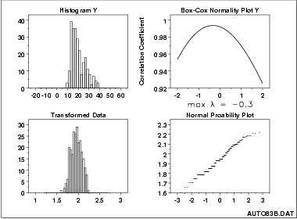

Box Cox Transformation

Slide 19
Transforming Categorical VarS – One-Hot
One-of-K encoding on an array of length K.
Basic method: Used with most linear algorithms
Make sure you don’t introduce collinearity
Dropping first column avoids collinearity
What to do if you have lots of different values?
Sparse format is memory-friendly
What if the test data contains unseen values?
Most current implementations don’t gracefully treat missing, unseen variables

Slide 20
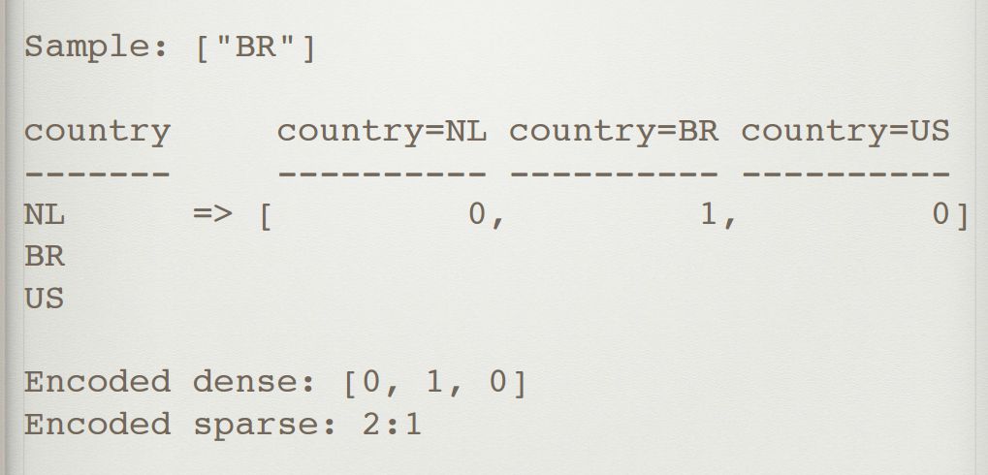
One Hot Encoding - Example

Slide 21
Hash Encoding
Does “OneHot-encoding” with arrays of a fixed length
Avoids extremely sparse data
May introduce collisions
Can repeat with different hash functions and bag result for small bump in accuracy
Collisions usually degrade results, but may improve it
Gracefully deals with new variables (eg: new user-agents)

Slide 22
Count Encoding
Replace categorical variables with their count in the train set
Useful for both linear and non-linear algorithms
Can be sensitive to outliers
May add log-transform, works well with counts
Replace unseen variables with `1`
May give collisions: same encoding, different variables

Slide 23
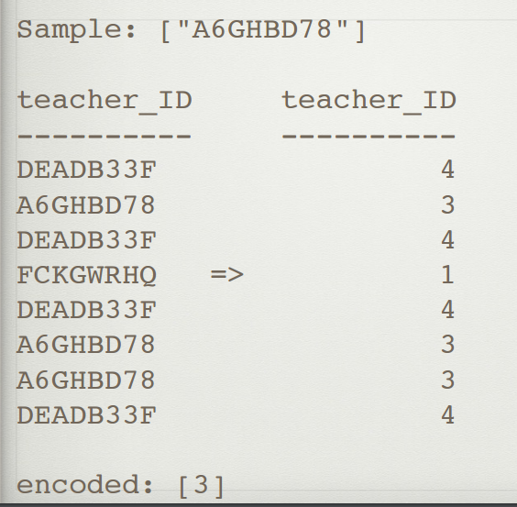

Slide 24
Applied Data Science Feature Engineering
Dr. Omri Allouche
2017

Slide 25

Coming up with features is difficult, time-consuming, requires expert knowledge. “Applied machine learning" is basically feature engineering.
- Andrew Ng

Slide 26
…some machine learning projects succeed and some fail. What makes the difference? Easily the most important factor is the features used.
- Pedro Domingos
“A Few Useful Things to Know about Machine Learning”

Slide 27
Create multiple categorical variables from a single variable
Some high cardinality features, like user-agents, hold far more information in them:
is_mobile?
is_latest_version?
Operation_system
Browser_build
Etc.

Slide 28
Coming Up with Features – Business Understanding
Ask business people what they think is predictive of the outcome
Some ideas might be anecdotal
Some might include data you don’t (currently) have available
Some might require an approximation of the ideal data described by the business people
Your job is to translate all of this into features.

Slide 29
RFMVT - Creating New Features
Recency. Signals how old certain event is.
Frequency. Signals how often does certain events occur.
Monetary. Any numerical representation of direct of indirect business value of an example.
Variety. How many distinct items are found for certain type of an example.
Tenure. How much time has elapsed since the first appearance of certain example or of an example of certain type.

Slide 30
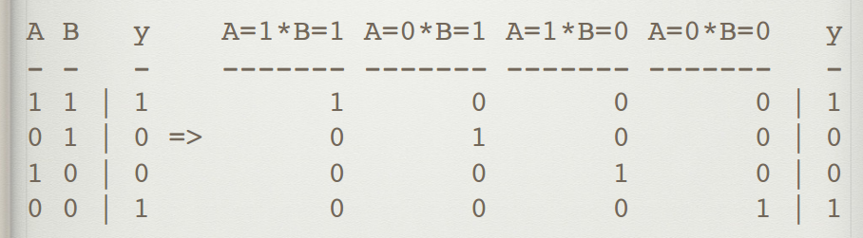
Interactions
Specifically encodes the interactions between numerical variables
Try: Substraction, Addition, Multiplication, Divison
Use: Feature selection by statistical tests, or trained model feature importances
Ignore: Human intuition; weird interactions can give significant improvement!
A polynomial kernel can solve XOR

Slide 31
Feature engineering Examples
is_null
Dummy variables
Make sure you don’t introduce colinearity
What to do if you have lots of different values?
What if the test data contains unseen values?
Notes:
Create dummy vars for common variables + shared value for rare variables

Slide 32
Features when grouping
E.g. we have data about purchases, we’re interested in data about customers
Number of rows
Average/median/mode/min/max/std etc.
Number of NaN’s
Number of 0’s
Number of negative values
For categorical data, nunique()
#/% of most common value
Entropy
Correlation between 2 columns

Slide 33
Trendlines
Instead of encoding: total spend encode things like:
Spend in last week
Spend in last month
Spend in last year
Gives a trend to the algorithm
Notes:
two customers with equal spend, can have wildly different behavior — one customer may be starting to spend more, while the other is starting to decline spending.

Slide 34
Coming Up with Features – Error Analysis
Review model errors (misclassifications)
Try to think why the model got these wrong
Look for insights that might lead to new ideas for features
Consult with people with domain expertise and business understanding

Slide 35
Circular Values - Projecting to a Circle
Turn single features, like day_of_week, into two coordinates on a circle
Ensures that distance between max and min is the same as min and min +1.
Use for day_of_week, day_of_month, hour_of_day, etc.

Slide 36
Additional Ideas
Closeness to major events
Closeness to Hubs
Cluster using an unsupervised method and use the cluster number
String Manipulations

Slide 37
Importance of Feature Engineering
You are given the company’s revenues and expenses. Using a decision tree, determine is the company profitable?

Slide 38
Problems with Feature Engineering
Feature Explosion
The Curse of Dimensionality
Longer training times
Larger memory requirements
Less interpretability
Potential of overfitting
How can we handle these?
Notes:
regularisation, kernel method, feature selection

Slide 39


Slide 40
Kobe Bryant’s Shots https://www.kaggle.com/selfishgene/kobe-bryant-shot-selection/psychology-of-a-professional-athlete http://adataanalyst.com/kaggle/kaggle-tutorial-kobe-bryant/
Open Discussion

Slide 41
e-Commerce Site Analytics
Open Discussion

Slide 42
How to measure what we want?
eCommerce Analytics
Market Basket Analysis
Transaction Fraud
Customer churn
Customer satisfaction

Slide 43
Homework
Read https://www.analyticsvidhya.com/blog/2016/01/guide-data-exploration/
Read https://www.quora.com/What-are-some-best-practices-in-Feature-Engineering/answers/5062347?srid=3dUC
Read https://www.analyticsvidhya.com/blog/2016/01/12-pandas-techniques-python-data-manipulation/

